Slide 1
CS 470 Project Two Conference Presentation: Cloud Development
Courtney Maxwell
December 2024

Slide 2
Overview
Intro
Containerization
Orchestration
The Serverless Cloud
Developmental Principles
Securing Your Cloud App
Notes:
Hello, my name is Courtney Maxwell. I currently work for an IT company called Ensono and am in my last semester to receive a Bachelors in Computer Science. Today I will be covering the key concepts and benefits of cloud computing.

Slide 3
Containerization
Models
Software-as-a-Service
Refactoring
Replatforming
Tools
Docker
Docker Compose
S3
Notes:
Containerization is the process of bundling an application’s code with all the required files and libraries. This is done in Docker using containers which are virtual packages that contain code, dependencies, libraries, system tools, runtime, etc. The models and tools mentioned here allow for easier management, scalability, and portability across environments.

Slide 4
Orchestration
Why use Docker Compose?
Simplified configuration
Collaboration
CI/CD integration
Rapid development
Notes:
Docker compose is beneficial for many reasons as shown here. It allows simplified configuration through containerization as previously discussed. Using Docker Compose, team members can set up and make changes to the development environment in real-time, encouraging collaboration. CI/CD integration stands for Continuous Integration and Continuous Delivery/Deployment. These two terms refer to automated integration and deployment of code changes to provide updates to the production environment as needed.

Slide 5
The Serverless Cloud
Serverless
Advantages
No server management
Pay-per-use billing
Automatic scaling
Faster development
Notes:
Serverless computing is an execution model that allows developers to build and run applications without having to manage any servers by allocating resources only on an as-needed/used basis.

Slide 6
The Serverless Cloud
S3 Storage vs Local Storage
S3 Storage
Serverless
Unlimited
High availability
Pay-as-you-go
Object format
Local Storage
More secure
Usually faster
No need for internet
No extra cost
File System
Notes:
A serverless cloud uses S3 storage as opposed to local storage. In this slide we can see the differences between the two. S3 storage… Local storage…

Slide 7
The Serverless Cloud
API & Lambda
Advantages:
Automation
Scalability
Efficiency
Scripts used:
Java
Powershell
FastAPI
Notes:
Advantages of API & Lambda include automation, scalability, and efficiency. Scripts produced include Java, Powershell, and FastAPI.

Slide 8
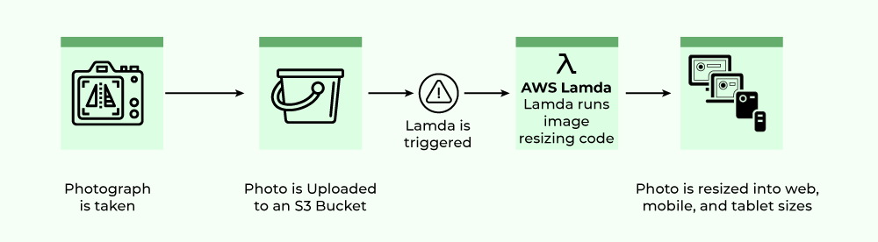
The Serverless Cloud
API & Lambda
Lambda API Logic
Notes:
We can see the Lambda API logic in the image above. It also shows the steps required to integrate the frontend with the backend. The frontend is where the user takes a photo, that photo is then uploaded into S3 storage. Lambda then receives a signal to resize the image based on the requirements of the device being used. The photo has now reached the backend where it is resized and communicated back to the user.

Slide 9
The Serverless Cloud
Database
MongoDB vs DynamoDB
MongoDB can be run in any cloud or locally, DynamoDB is only available on AWS
MongoDB uses document-oriented models, DynamoDB uses key-value models
MongoDB supports rich query capabilities, DynamoDB supports simple key-based lookups
Queries performed: find() method, MongoDB Query, DynamoDB Query
Scripts used: MongoDB, mongosh, Bash script, Javascript
Notes:
MongoDB is more ideal for complex queries, more flexibility in the data structure, and deployment across multiple providers. DynamoDB is a better option for fast key-value lookups, tight integration with other AWS services, and automatic capacity scaling.

Slide 10
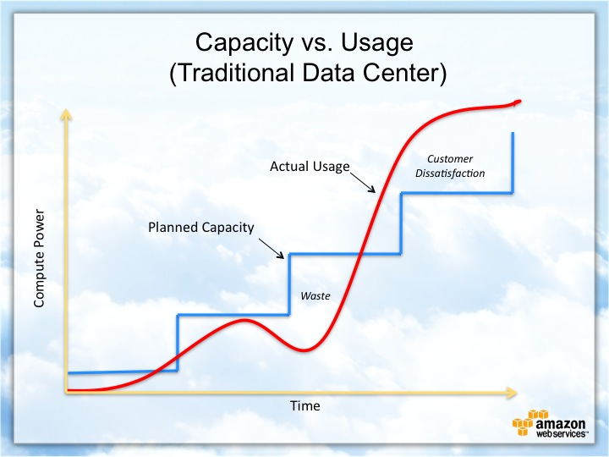
Cloud-Based Development Principles
Elasticity - scalability
Pay-for-use model – user pays for what they use
Notes:
Elasticity can be described as the ability of a system to scale computing resources up or down depending on the user demand. Pay-for-use is a model design where the user only pays for what they use. The graph pictured shows the correlation between time used on the system and the capacity of the system. As we can see, the higher the usage compared to the planned capacity, the higher the customer dissatisfaction.

Slide 11
Securing Your Cloud App
Access
Policies
API Security
Use strong passwords with MFA encryption
Principle of least privilege
Regularly update software
Identifying and classifying sensitive data
Role – an identity that can access resources
Policy – defines permissions given to that identity
Custom policies for this app were created using IAM default policy settings
Authentication and authorization controls to secure Lambda to Gateway
IAM policies
Lambda database connection
S3 Bucket
Notes:
Securing your app requires strong passwords with MFA encryption, policies and roles that identify and define the permissions given to each user, and ensuring authentication and authorization controls between Lambda and API Gateway. IAM policies are documents that define permissions for users and resources. Lambda can connect to databases like DynamoDB using different types of functions. S3 buckets are containers that are similar to file folders. They store, retrieve, back up, and access data associated with the system or app.

Slide 12
Conclusion
Security – security is one of the most important parts of IT due to the amount of sensitive data collected by the system
Scalability – scalable systems allow for quick and easy changes with minimum to no down-time for the app
Lambda, API, and Databases
Thank you for your time.

Slide 13
Citations
Introduction To AWS Lambda. (2018, August 22). GeeksforGeeks. https://www.geeksforgeeks.org/introduction-to-aws-lambda/

